Slide 1
ANLY 510 Analytics II: Principles & Applications
Instructor: Ziyuan Huang, Ph.D.

Slide 2
Course Information
Everything you need to know about the course is in the syllabus – as things change during the course the syllabus will be updated on Canvas.
Please check the syllabus frequently for updates mentioned in class.
If you ever have any questions, please contact me through MS-Teams.
Make sure to read the syllabus and ask if you have any questions.

Slide 3
Grading
Weekly Labs 15% (Sunday midnight)
3 Exams 60% (20% each – cumulative by nature)
3 In-Class Assignments 15% (5% each – cumulative by nature)
Attendance 10%
The graduate school valid grades are A, B, C, and F. Please note that any grade below a C (anything below 70% as outlined above) is an F. Grading will not take place on a “curve” and late work cannot be made up. If you feel you are getting behind at the start you can either withdrawal from the class, or in special circumstances we can discuss an incomplete: Incompletes must be made up by the start of the following term.
One chance to redo, one of your homework (bad score) or exam (your computer doesn’t work).

Slide 4
Expectation
After this class, you should be able to know:
How to recognize your data
How to use different methods to analysis your data
How to use proper ways to explain your findings
This is a graduate level course and I expect graduate level work. As such, poorly formatted work (e.g., work missing your name, class, assignment, or work with copy and pasting besides code) will be given an automatic F.
Cheating and plagiarism will be given an automatic F and will be reporting to the university.

Slide 5

What is Analytics

Slide 6
Why Analytics?
Analytics refers to tools that help finding hidden patterns in DATA.
Why it is so important?
For the past few decades, businesses generate more DATA than they are able to use or know HOW TO USE.
The Big Data revolution.
The three Vs: Volume, Velocity and Variety.

Slide 7

Experimental Design

Slide 8
Why Experiments?
We perform experiments to get unbiased answers to our questions.
Planned experiments give us control over the data we collect; this allows us to ensure the conditions are met for simpler analyses and stronger predictions.
Observational experiment (data collected in the wild) offer almost no control but allows for the most natural experimental space and allows us to exam things we can’t replicate in the lab (e.g., moral reasons).

Slide 9
The Experimental Procedure
The most important part of any experiment is the design.
Why?
With a good design you can get clear answers to your questions, a poor design can lead to uninterpretable data or wrong conclusions.
What should we do?
How to ask the right question to identify what we don’t know?
Wet lab experimental design (mouse), how many mice do we need? Gender? Age? Type? What kind of scientific questions that we may ask? Blood? Skin? Gut microbiome sample? Cancer data? CT images?

Slide 10
The Experimental Procedure
1 - Identify the question: What are the issues/questions you want to know/solve/recognize?
For example, is price or quality more important in valuation of a product?
relationship between price and product / relationship between quality and product
interactions between price and quality / price + quality = product.
2 - Map out your question space (human disease or mouse disease): Make sure in the study, you are able to measure/detect the variable you actually want to.
For example, how will we manipulate price and quality? What other (confounding) factors might play a role in our experiment that we cannot fully control for?
3 - Design: How do we perform the research?
We need to pick the best method for answering our question and dealing with our confounds. How will we analyze our data and what are the assumptions of those analyses.
human disease – different method - HIPPA
animal disease – different method - IACOC

Slide 11
The Experimental Procedure
4 - Conduct the experiment: Run the data experiment as planned, ensuring all data points are generated without bias (e.g., different experimenter phrasing, differences due to translation, etc.)
5 - Understand the data: Once you have data you need to ensure it meets the analytical assumptions for the analysis you wish to employ. You may need to correct the data in some way. Then conduct your analyses: My method is to employ the simplest test of my hypothesis, then I use more sophisticated analysis to get a better understanding the effect(s).
6 - Analysis and report: Using appropriate method(s) and be able to interpret your results in a proper way (statistics)

Slide 12

Data Collection

Slide 13
Before collecting your data
Two things should be known:
What to measure?
How to measure?

Slide 14
Variables
What is a variable?
To test hypothesis we need variables.
Independent variable (IV): A variable we think is a cause (maybe yes or no), as know as predictor
For example, coca cola and weight
Dependent variable: A variable we think is an effect, as know as outcome
For example, coca cola and weight

Slide 15
Levels of Measurement
The relationship between what is being measured and the number that represent what is being measured.
Categorical variable: made up of category. For example, groups, conditions, etc.
Binary variable: two directions/two levels/yes-no/positive-negative
Nominal: more than two groups, brand A/brand B/brand C/brand D
Ordinal variable: when categories are ordered. For example, a race competition
A/B/C/F - Gold/Silver/Copper - First/Second/Third

Slide 16
Levels of Measurement
Continuous variable: provides score for each entity.
Interval: each entity has equal intervals.
Ratio: adding a zero, and the scale should be meaningful. For example, age.
Discrete: take only certain numbers. For example, likert scale.

Slide 17
Errors and Experiment
What is an error?
Systematic error vs random error.
Correlational Research methods vs Experimental Research Methods

Slide 18
Randomization
Why randomize?
To keep the error minimized.
Why does randomization work?
Relationship between randomization and central limit theorem?
n = 30, why randomized sample number of 30?

Slide 19

Simple Comparative Analyses
A
VS.
B

Slide 20

After data collection
We talked about designing an experiment to compare whether Price on people’s valuations of a product (lets call this a measure of preference).
When coming up with this experiment we would have had a hypothesis. Let’s assume that people are generally influenced by price.
VS.

Slide 21
Hypothesis
What is a hypothesis?
How and why do we need it?
Null Hypothesis (H0): the hypothesis that there is no significant difference between specified populations, any observed difference being due to sampling or experimental error.
Alternative Hypothesis (H1): a position that states something is happening.

Slide 22
After data collection
Back to our study, what are the hypothesis?
Null Hypothesis?
Alternative Hypothesis: Preferences for a product will be higher when the price is lower.
Our dependent variable is what? Is it categorical, discrete, or continuous?
Our predictor variable is what?

Slide 23
Central Tendency
Say we had 20 participants (10 per condition) give us their preferences for the product.
We would like to get an idea of which condition leads to greater preference, what measure of central tendency should we use?
Mean, median and Mode?
Mean: 54 vs 68.4, Median: 57.5 vs 74.5
High | 55 | 40 | 90 | 75 | 62 | 71 | 30 | 45 | 60 | 12
Low | 75 | 88 | 91 | 25 | 87 | 13 | 100 | 74 | 58 | 73

Slide 24
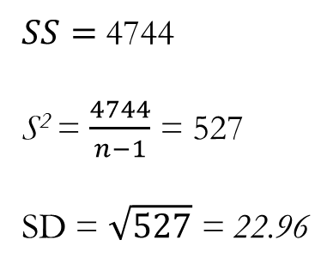
Measures of Variability
To find the variance (S²) we subtract the mean from each observation, square, and then sum these squares (the SS or Sum of Squares) and divide by sample size (n) minus 1.
The SD and ȳ are point estimates.
Point estimates should be:
Unbiased so that if infinite samples were drawn our sample estimates would equate toe the true populations from which they are drawn.
They must have minimum variance, specifically they must have less variance than alternative estimators.
High Price
(55 – 54)² = 1
(40– 54)² = 196
(90– 54)²= 1296
(75– 54)²= 441
(62– 54)²= 64
(71– 54)²= 289
(30– 54)²= 576
(45– 54)²= 81
(60– 54)²= 36
(12– 54)²= 1764
$SS=$ 4744
S² = $\frac{4744}{n−1}$ = 527
SD = $\sqrt{527}$ = 22.96
Degrees of Freedom (df): Is the number variables estimated, will become more important later when we use test statistics (t, f, etc.).

Slide 25
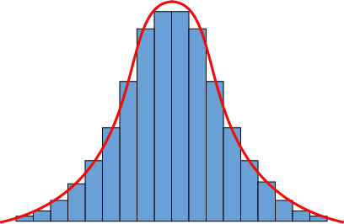
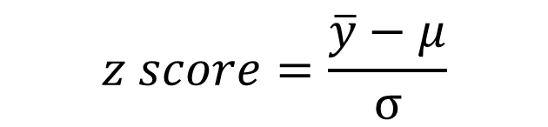
Distributions: Normal
A normal distribution has a given µ and σ, so we can say a given y is pulled from a normal distribution with a mean of µ and a standard deviation of σ, or N(µ, σ).
The standard normal distribution has a µ = 0 and σ = 1.
The Central Limit Theorem indicates that for samples from any distribution (even non-normal) with a large enough size the mean of those samples will be normally distributed.
$$z score=\frac{\overline{y}−μ}{σ}$$

Slide 26
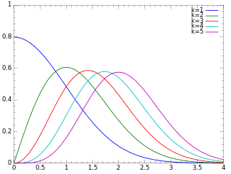
Distributions: Chi Square (χ²)
The χ² is estimated assuming that samples are drawn from a normal distribution.
In short, the idea is if you have a normal distribution and you were to randomly draw and square samples from it the distribution of those values would be a χ² distribution.
As such, the larger the sample the more normal the distribution becomes.
Mostly use in inferential statistics, i.e. hypothesis testing.

Slide 27
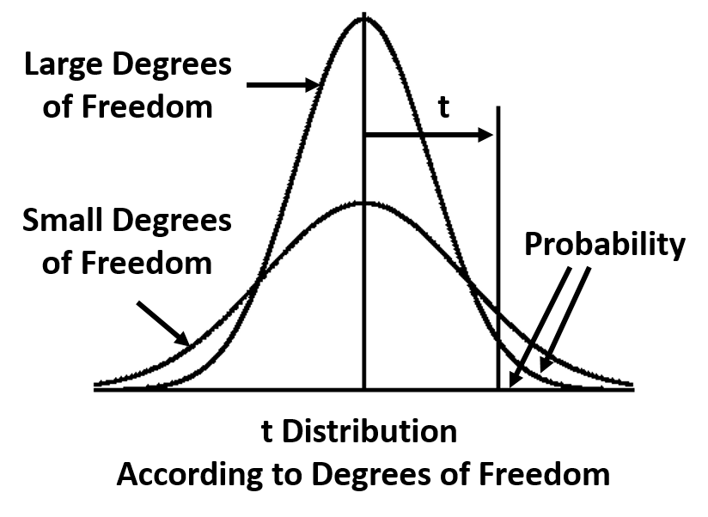
Distributions: Students t or t
We use the t distribution when the variance is unknown and our sample size (n) is small.
The t distribution is ~ normal with enough samples.
When the number of samples is small the t distribution has a flatter center and thicker tails.

Slide 28
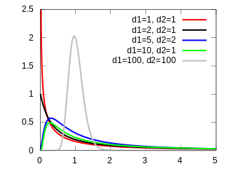
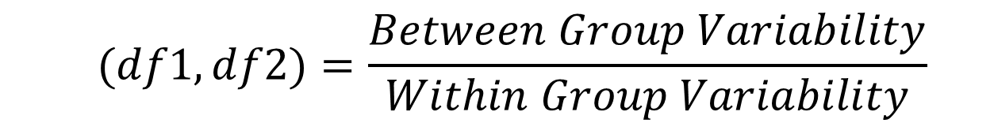
Distributions: Snedecor's F or just F
We use the F distribution when examining if two + conditions differ.
Like other distributions the F is normal when sample sizes are sufficiently large.
When the number of samples is small the F distribution will have increased positive skew).
$$F(df1, df2)=\frac{Between Group Variability}{Within Group Variability}$$

Slide 29

T-tests

Slide 30
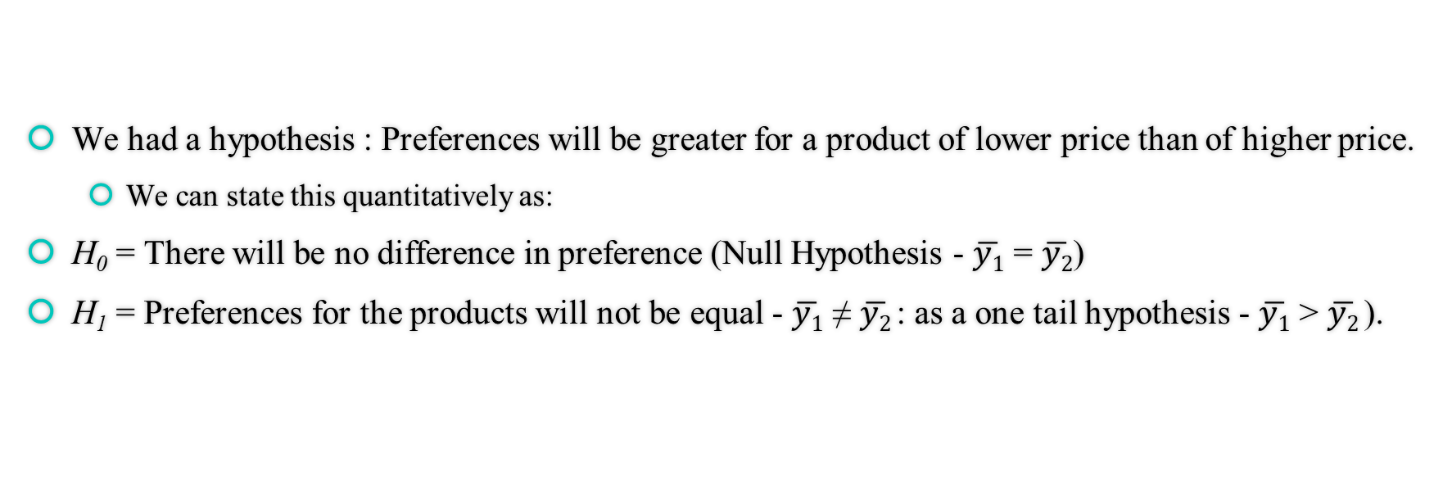
Let’s Do Some Data Science
We had a hypothesis : Preferences will be greater for a product of lower price than of higher price.
We can state this quantitatively as:
H₀ = There will be no difference in preference (Null Hypothesis - $\overline{y1}$ = $\overline{y2}$)
H₁ = Preferences for the products will not be equal - $\overline{y1}$ ≠ $\overline{y2}$: as a one tail hypothesis - $\overline{y1}$ > $\overline{y2}$).

Slide 31
Let’s Do Some Data Science
We need to decide our test statistic (which would work well here?) and a critical value (region) for the test (p < .05, .01, .001, etc.).
There are two types of error we try to minimalize:
Falsely rejecting the null when its true (Type I Error = α)
Falsely rejecting the alternative hypothesis when it is true (Type II Error = β)
To calculate Power to detect an effect we take 1 – β; many journals ask for .90 or higher.

Slide 32
The Null
There are a few thing to bear in mind with a null result:
It could be that you have a great deal of error/noise (maybe people believe that lower price means lower quality.)
It could be you got unlucky and got a Type II error.
The effect does not exist.

Slide 33
T-Test: Assumptions
Normality: sampling distribution is normally distributed
Type of variable: data are measured at least at the interval level.
Equal Variance: whether the variances are equal between the two groups
Independence: Scores in different conditions are independent.

Slide 34

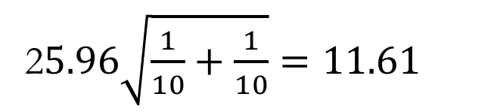
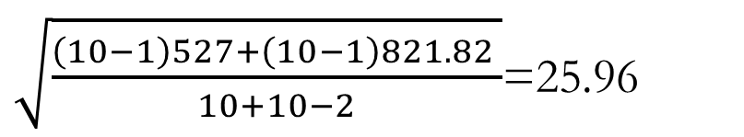
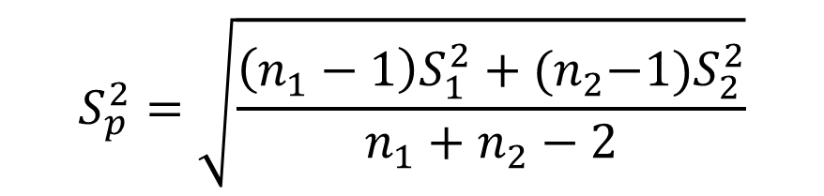
Test It: Two Sample t-Test
Let’s use a standard value (significance value) of p = .05, anything < .05 will be significant.
Mean difference between conditions
54 – 68.4 = -14.4
n₁ + n₂ = 20
2 independent factors
df = 20 – 2 = 18
t(18) = -1.24
Critical t is ±2.1
p > .05 thus we fail to reject the null
$$t(df)=\frac{\overline{y1}−\overline{y2}}{S_{p}\sqrt{\frac{1}{n_{1}}+\frac{1}{n_{2}}}}$$
2$5.96\sqrt{\frac{1}{10}+\frac{1}{10}}=11.61$
$$S_{p}^{2}=\sqrt{\frac{\left(n_{1}−1\right)S_{1}^{2}+{(n}_{2}−1)S_{2}^{2}}{n_{1}+n_{2}−2}}$$
Standard Error of the Mean
Combined (Pooled) Variance
$\sqrt{\frac{\left(10−1\right)527+\left(10−1\right)821.82 }{10+10−2}}$=25.96

Slide 35


Test It: Two Sample t-Test unequal variances
The standard t-test assumed that the variances in each condition are ~ equal.
Our values were fairly close: 22.96 and 28.66
However, if we estimated them to be different (visually inspect and use Levine's) we need to change up our t-test a bit.
$$t(df)=\frac{\overline{y1}−\overline{y2}}{\sqrt{\frac{S_{1}^{2}}{n_{1}}+\frac{S_{2}^{2}}{n_{2}}}}$$
$$df=\frac{{\left(\frac{S_{1}^{2}}{n_{1}}+\frac{S_{2}^{2}}{n_{2}}\right)}^{2}}{\frac{{\left(S_{1}^{2}/n_{1}\right)}^{2}}{n_{1}−1}+\frac{{\left(S_{2}^{2}/n_{2}\right)}^{2}}{n_{2}−1}}$$

Slide 36
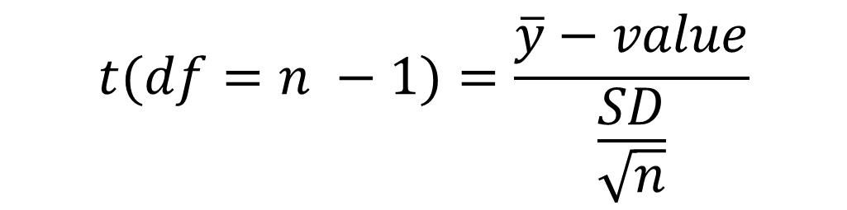
Test It: One Sample t-Test
In some instances we might want to compare some sample mean to a predicted mean (e.g., we are only interested if a treatment leads to an x amount increase).
We could test for this using a fairly simple t score:
$$t(df=n −1)=\frac{\overline{y}−value}{\frac{SD}{\sqrt{n}}}$$

Slide 37


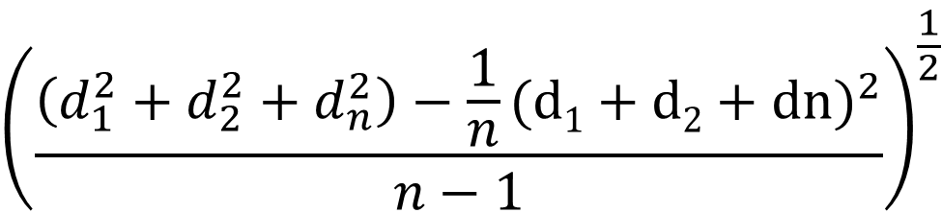
Test It: Paired Samples t
A clean design that helps limit external factors is a paired samples (within subject) design.
$$\frac{1}{n}(d1+d2+…dn)$$
$$t(df=n −1)=\frac{\overline{d}}{\frac{SD}{\sqrt{n}}}$$
$${\left(\frac{\left(d_{1}^{2}+d_{2}^{2}+d_{n}^{2}\right)−\frac{1}{n}{(d1+d2+dn)}^{2}}{n−1}\right)}^{\frac{1}{2}}$$

Slide 38
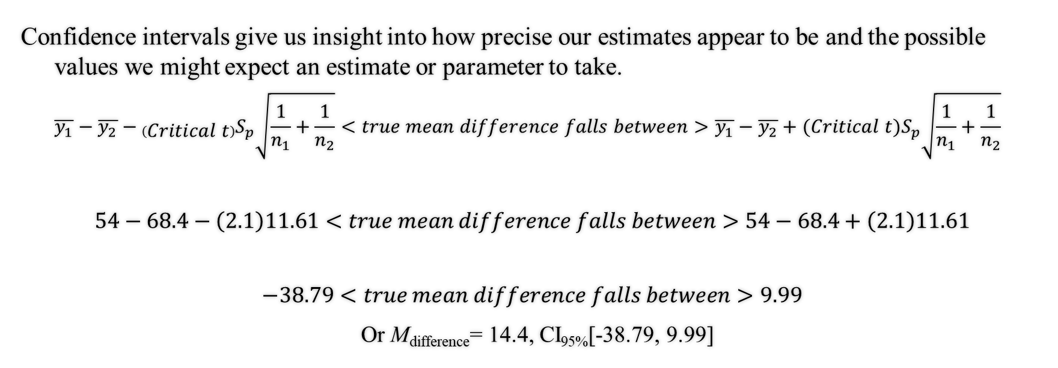
Confidence Levels
Confidence intervals give us insight into how precise our estimates appear to be and the possible values we might expect an estimate or parameter to take.
$$\overline{y_{1}}−\overline{y_{2}}−\left(Critical t\right)S_{p}\sqrt{\frac{1}{n_{1}}+\frac{1}{n_{2}}}<true mean difference falls between>\overline{y_{1}}−\overline{y_{2}}+(Critical t)S_{p}\sqrt{\frac{1}{n_{1}}+\frac{1}{n_{2}}}$$
$$54−68.4−\left(2.1\right)11.61<true mean difference falls between>54−68.4+\left(2.1\right)11.61$$
$$−38.79<true mean difference falls between>9.99$$
Or M_{difference}= 14.4, CI_{95%}[-38.79, 9.99]

Slide 39

Applications

Slide 40
One Sample t-test
Suppose we are interested in whether a new manufacturing technique takes more/less time than our current system in which the mean manufacturing time is 43.4 minutes.
Our data would be a single column with observed times in the rows, like this:
To perform a one sample t-test in R we would enter the command:
ttest(Time, mu = 43.4, alternative= “two.sided” “greater“ or “less”)
t = 1.4452, df = 9, p-value = 0.1823
t = 1.4452, df = 9, p-value = 0.09115
t = 1.4452, df = 9, p-value = 0.9088
Time
86
73
50
73
24
65
84
54
16
26

Slide 41
Analysis
Assumption:
D'Agostino skewness test: Null -> the data does not have skewness
agostino.test
Shapiro-Wilk normality test: Null -> the data is normally distributed
shapiro.test
T-test:
t.test(data, mu = mean)

Slide 42
In Class Practice
Time
90
68
57
76
39
65
84
68
46
29
We know the mean is 35 and we would like to know if there is any different between the new machine.

Slide 43
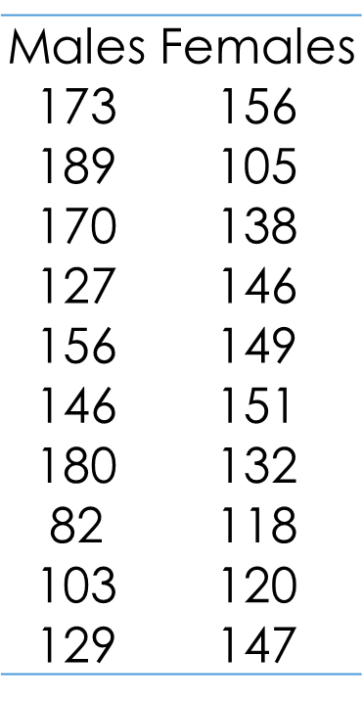
Independent t-test
Suppose we have data on cholesterol levels for males and females and we wish to see if one sex has higher/lower LDL cholesterol (i.e., the bad kind) than the other.
Our data would look something like this:
t.test(Males, Females, var.equal = TRUE/FALSE, alternative)
t = 0.75715, df = 18, p-value = 0.4588
t = 0.75715, df = 12.995, p-value = 0.4625

Slide 44
In Class Practice
Male: 169, 175, 172, 122, 135, 149, 177, 99, 103, 123, 256
Female: 123, 105, 122, 136, 136, 156, 142, 109 ,123, 151, 107
Is there any difference in terms of cholesterol level between male and female?

Slide 45
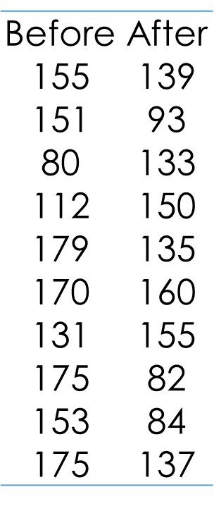
Paired Samples t-test
Suppose we are interested in whether a drug reduces the level of bad cholesterol significantly.
We measure cholesterol before and after treatment.
Our data would look something like this:
t.test(Before, After, paired = TRUE, alternative = 'two.sided’)

Slide 46
Summary Write Up
In the current study, the researcher examined the difference of cholesterol between gender. Performing an independent t-test (equal variances assumed) we find there is no significant difference between male (M = 145.5; SD = 34.96) and female (M = 136.2; SD = 16.92), t(18) = 0.76, p = . 45.

Slide 47

Categorical Variables

Slide 48
Simple Tests For Categorical Dependent Variables
In simple cases when dealing with a categorical dependent variable we use Chi Square (χ²) analyses. There are two main types of Chi-Square test used in quantitative decision making.
Chi Square Goodness of Fit –when we wish to compare an observed frequency to an expected one.
Chi Square Test of Independence – when we wish to see if two groups differ in their observed frequencies across a categorical dependent variable.

Slide 49
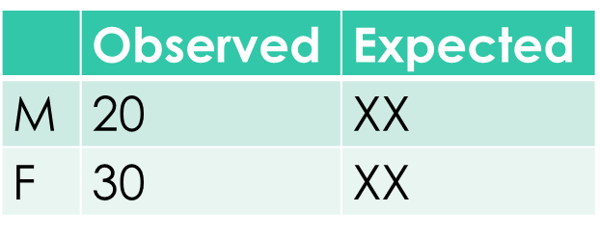
Chi Square Goodness of Fit
Goodness-of-Fit
Compares observed vs expected counts in one variable
Suppose we know that the percentage of females in the population is 51% and we want to see if this percentage is also present in our class. In other words we wish to see if ~51% of our class are female as would be expected based on their proportion of the population.
We have XX females in our class and XX males so we can see that we are 51% female, but is this significant?
We first want to create an observed variable that has XX in the row for females and XX in the row for males. Then we create a variable with the expected percentages of males and females. Our data this would look something like:
In R chisq.test(Observed, p = Expected)
X-squared = XXX, df = 1, p-value = XX

Slide 50
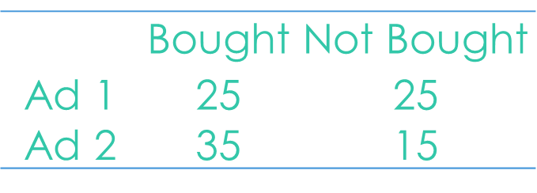
Chi Test of Independence
Independence
Assesses association between two variables
Imagine we have run a marketing study where we are interested in whether one of our two conditions increases the likelihood that a person buys a product.
Suppose this is the data we get:
We have to play with the data a bit, and since its fairly simple data we can just enter it:
Advertisement 1 <- c(25, 25) # Creating AD 1 Row
Advertisement 2 <- c(35, 15 ) # Creating AD 2 Row
Data <- as.data.frame(rbind(AD1, AD2)) # Creating Data Frame
names(Data) = c(“Bought”, “No”) # Labeling Columns
chisq.test(Data) # Performing Test
X-squared = 3.375, df = 1, p-value = 0.06619

Slide 51
In Class Practice
Kidscalories – children either don’t help (2) or help (1) making dinner and the amount of food they consume is measured. Find which method gets them eating more.
Cholestoraldata – cholesterol levels for the same individuals following a month of using two different brands of margarine. Determine if one lowers cholesterol more than another.
PrioritiesData – students school priorities based on their location. Determine if there are any differences in priorities by location.
VotingData – the order candidates from different parties are listed on the ballot and what candidate is selected. Determine if listing order impacts voting

